Slide 1
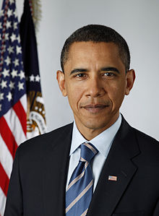
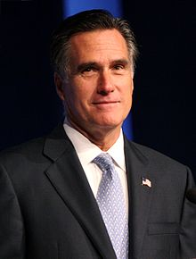
Fort Bend ISD Mock Election 2012

Slide 2
How To Vote
Click on the link below to vote:
http://mockelection.fortbendisd.com/
Follow the directions on the next slide

Slide 3
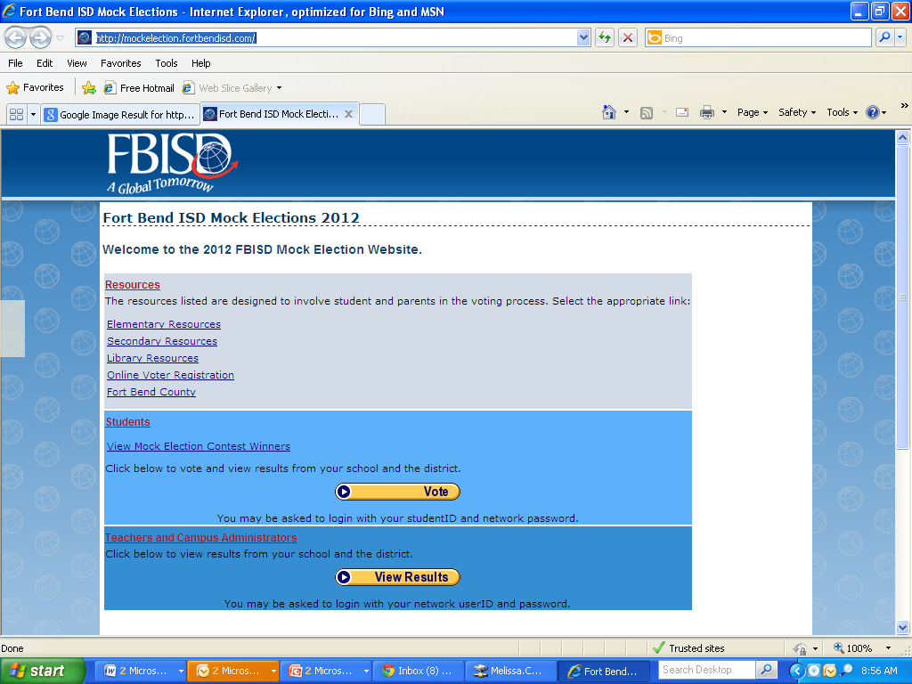
Click Here to Vote

Slide 4
Select the candidate of choice and then click on “Submit their Vote”

Slide 5
Your Parents Can Vote TOO!
For Parents to Vote
Go to same website as before.
Click on the vote button in the student section of the webpage.
Enter your child’s ID number and password to enter the voting site.
Click on the “Parents Vote” button.
Select the candidate of choice and then click on “Submit their Vote.”
Each student is allowed to have two parent votes cast.
The system does not limit if a parent has multiple students in the district. We ask that they vote only one time and be sure to explain to their children that in the real election people are only allowed to vote once.

