Slide 1
2.21.13
What 3 beliefs was Manifest Destiny based on?
Who came up with the name, “Manifest Destiny?”
Who was the President at the time America reached the shores of the Pacific Ocean, and accomplished Manifest Destiny?

Slide 2
2.22.13
Video Question
1. After watching the video, how does “Elbow Room” relate to Manifest Destiny?

Slide 3
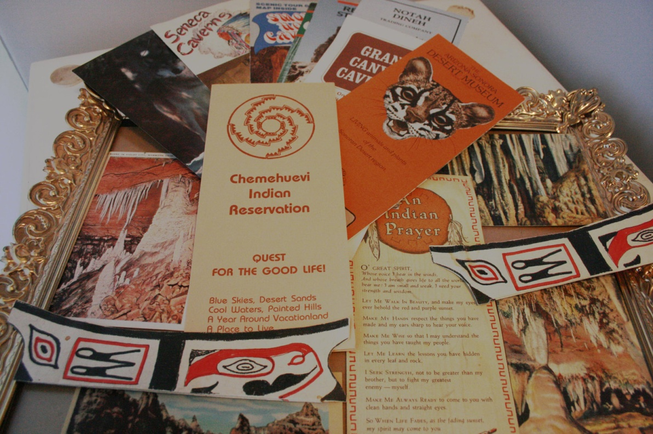
Manifest Destiny Brochure

Slide 4
Brochure
Using the Manifest Destiny notes handout, create a brochure that includes information about each new acquisition to America.
Choose 5 of the 7 acquisitions/regions to include on your brochure.
You must include the following: who we acquired the land from, geographic features, how did we get it, why did we want it, year it was acquired, states located in the territory today, picture to represent the region.

Slide 5
Fold paper into 3 columns- you will use both sides
Title Page: Include the following:
-name and class period
-What is Manifest Destiny?
-Pictures and symbols
Acquisition #1
A title of your region
Who we got it from
Geographic features
How we got it (War? Treaty? Purchase?)
Why we wanted it
what year it was acquired
what states are located in the territory today
Shade in the region in your map
A PICTURE TO REPRESENT THE REGION
Acquisition #2
A title of your region
Who we got it from
Geographic features
How we got it (War? Treaty? Purchase?)
Why we wanted it
what year it was acquired
what states are located in the territory today
Shade in the region in your map
A PICTURE TO REPRESENT THE REGION

Slide 6
Fold paper into 3 columns- you will use both sides- total of 6
Acquisition #3
A title of your region
Who we got it from
Geographic features
How we got it (War? Treaty? Purchase?)
Why we wanted it
what year it was acquired
what states are located in the territory today
Shade in the region in your map
A PICTURE TO REPRESENT THE REGION
Acquisition #4
A title of your region
Who we got it from
Geographic features
How we got it (War? Treaty? Purchase?)
Why we wanted it
what year it was acquired
what states are located in the territory today
Shade in the region in your map
A PICTURE TO REPRESENT THE REGION
Acquisition #5
A title of your region
Who we got it from
Geographic features
How we got it (War? Treaty? Purchase?)
Why we wanted it
what year it was acquired
what states are located in the territory today
(Shade in the region in your map
A PICTURE TO REPRESENT THE REGION

