Slide 1
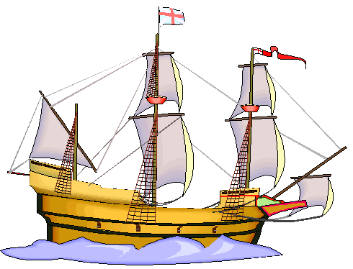
Mayflower
1620
1. Reasons for coming:
2. Who:
Where:
3. Government:
4. Significant People:
5. Hardships
6. Supplies
Using these notes, indicate the 5 themes of History:
Social:
Economic:
Morale:
Political:
Geography:

Slide 2
Mayflower
1620
Reasons for coming:
Religious Freedom
-if not in Church of England, burned at stake.
2. Who: Pilgrims/Separatists/Puritans
Where: New England Colony: Plymouth, Massachusetts
3. Government:
Representative Government
Mayflower Compact
4. Significant People:
William Bradford (leader)
Squanto (Native American
who helped plant, farm,
and hunt)
5. Hardships
Voyage 66 days
Crowded conditions
Disease
Sea sickness
storms
6. Supplies
Water
Food
Seeds
Tools
Medicine
Bible
Using these notes, indicate the 5 themes of History:
Social:
Economic:
Morale:
Political:
Geography:

Slide 3
