Slide 1
STAAR Review Folder Directions

Slide 2
Front of the Folder- Remember to leave room for your ideas next to each vocabulary term.

Slide 3
Supreme Court Decisions Marbury v. Madison McCulloch v. Maryland Gibbons v. Ogden Worcester v. Georgia Dred Scott v. Sandford
Hot Dates 1607- 1620- 1776- 1787- 1803- 1861-1865-
Presidents- Why Are Jeff’s Mad Monkeys Always Jumping Poor Lincoln?
Development of Political Parties: Federalists v. Republicans

Slide 4
Inside of the folder sides 1 & 2- Remember to leave room for your ideas next to each vocabulary term.

Slide 5
Foundations of Representative Government
Magna Carta
English Bill of Rights
Mayflower Compact
Virginia House of Burgess
Fundamental Order of Connecticut
John Locke
Montesquieu
Founding Documents
Declaration of Independence
Preamble
3 Parts
Articles of Confederation
U.S. Constitution
Great Compromise
3/5th Compromise
7 Principles of the U.S. Constitution
Individual Rights
Limited Government
Separation of Powers
Checks and Balances
Federalism
Popular Sovereignty
Republicanism
Bill of Rights- RASPP
Civil Rights Amendments

Slide 6
American Revolution
Causes:
Civil War
War of 1812
Significant People:
Causes:
Causes:
Battles:
Significant People:
Significant People:
Treaty of Paris 1783
Battles:
Battles:
Effect on the Industrial Revolution:
Appomattox Courthouse:

Slide 7
On the back cover of the STAAR Review Folder students will paste the following map and label the regions, cities and geographic features.

Slide 8
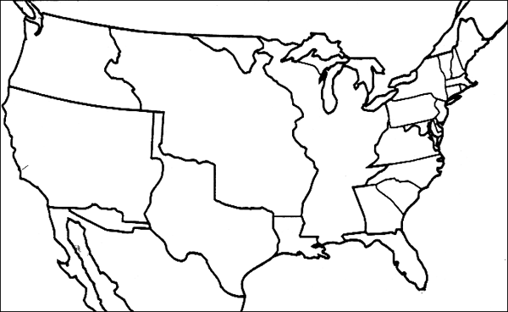
The United States 1776-1870 Map
Label the following Regions: New England Colonies, Middle Colonies, Southern Colonies, U.S. in 1787, Louisiana Purchase, Florida, Texas Annexation, Oregon Country, Mexican Cession, and Gadsden Purchase.
Label the following cities: Boston, New York, Philadelphia, Washington D.C., Richmond, Atlanta, New Orleans, Chicago, St. Louis, San Francisco.
Label the following geographic features: Atlantic Ocean, Appalachian Mts., Mississippi River, Rocky Mts., Pacific Ocean
New England Colonies:
Geography-
Economy-
Society-
Middle Colonies:
Geography-
Economy-
Society-
Southern Colonies:
Geography-
Economy-
Society-

